Slide 1
SDM notes
UML diagrams – Use case, class, sequence, activity, state machine
Notes about UML, Agile
Design Principles
Design Patterns
Design by Contract
Command-Query Separation
Domain Specific Languages (DSL) and Modelling Languages (DSML)
Model Driven Development

Slide 2
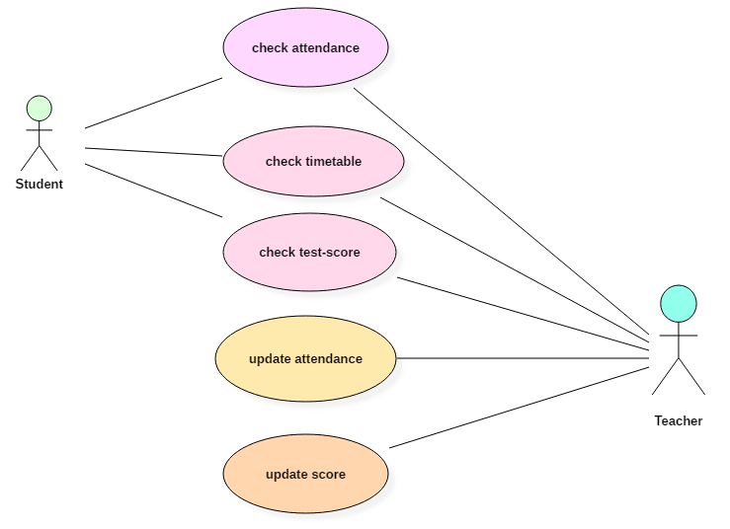
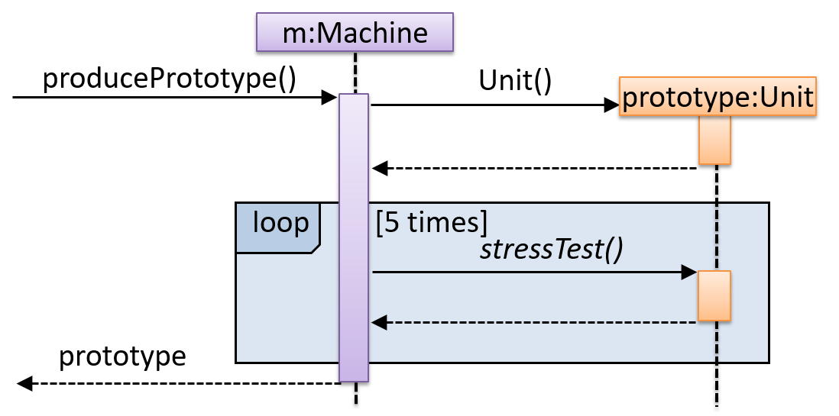
UML diagrams
verbs
Sequence diagrams
Use case diagrams
Activity diagrams
potential interactions
if:
opt
[cond]
alt
[cond]
if-else:
[else]
Parallel 1
Log in
Log out
Parallel 2
Choice 1
Choice 2

Slide 3
UML diagrams
Visibilities
+: public
-: private
#: protected
~: package
Underlined: static attribute/method
Book
-title: String
+numCopies(): Integer
1
0..*
Copy
Class diagrams
Navigability (A knows about B)
Inheritance/generalisation
Implementing an interface
Association class
is a copy of
Lollipop
Aggregation: contained can survive without the container
Composition: whole destroyed, parts destroyed (stronger aggregation)
A
B
Animal
Cat
AnimalShelter
AnimalShelter uses Animal interface, Cat implements Animal interface
Teacher
Person
Person
Group
Cat
<<interface>>
Animal
Chapter
Book
Student
Course
Enrollment
(not necessarily implemented as a separate class)

Slide 4
UML diagrams
Book
+borrowed(c:Copy) +returned(c:Copy)
Copy
-onLoan: Boolean
+borrow() +return()
1
0..*
State diagrams
Protocol state diagrams
For clients, shows actions ON object
Contains less information
Behavioural state diagrams
For implementors, shows actions ON object and actions BY object
Additional information shown in orange
is a copy of
can permutate attributes to find out num of possible states
State Machine for Copy
borrow() / book.borrowed(self)
Nested State Machine
On Shelf
On Loan
On
return() / book.returned(self)
Off
H
Low
Object creation
down
up
Object deletion
High
H/history: remembers previous state; if no previous, goes to low

Slide 5
Modes of using UML
UML as sketch
Communicate ideas; informal and dynamic
No need to be complete
UML as blueprint
Expresses all design decisions, emphasis on completeness
Programming should follow as a pretty straightforward activity
UML as programming language
Detailing the UML enough
Use tools that take the UML diagrams and compile them into executable code

Slide 6
Conceptual Class Diagram
Simply a step toward a proper class diagram
More informal language, no need to include visibilities or full method signatures, use normal English in constraints
Can comment on uncertain multiplicities, include questions etc
Agile Model
4 principles:
Individuals and Interactions over Processes and Tools
Working Software over Comprehensive Documentation
Customer Collaboration over Contract Negotiation
Responding to Change over Following a Plan
How to do it:
Find out where you are, take a small step towards your goal, adjust your understanding based on what you learned, repeat
When faced with two or more alternatives that deliver roughly the same value, take the path that makes future change easier.

Slide 7
“Simple” Design
Characteristics:
Pass tests (fundamental in programming)
Minimise duplication
Maximise clarity (improve names)
Has fewer elements
Characteristics of a bad design: Fragility, rigidity and immobility
Fragility: When you make a change, unexpected parts of the system break
Rigidity: Hard to change as every change affects too many other parts of the system
Immobility: Hard to reuse in another application because it cannot be disentangled from the current application
after debates, these 2 go hand in hand/ in a cycle, no one more impt than the other

Slide 8
Design Principles
Main goal: being able to change software easily when requirements change
Low coupling
Between components/classes/etc
Measure of degree of dependence
If a change to X could potentially require a change in Y
High cohesion
Within a component
How strongly-related and focused its responsibilities are
Modularisation
Separation of interface and implementation
(Through OOP)
Abstraction
Abstract away lower level details
Encapsulation
Packaging related data and behaviour into one self-contained unit
Hide info from unintended users, only accessible through interface

Slide 9
Design Principles
Law of Demeter
An object should only send messages to itself, parameters passed to it, objects it creates, or objects that are its attributes
To avoid indirect dependencies that may not be readily apparent from the code/UML diagram
However, can be disobeyed with a good rationale eg no better alternative

Slide 10
Design Principles: SOLID
Single Responsibility Principle (SRP)
A class should have one, and only one, reason to change
Open-Close Principle (OCP)
Written to be open for extension without being modified (closed for modification)
Often achieved by separating specification from implementation (via an interface)
Liskov Substitution Principle (LSP)
Subclasses must be substitutable for their superclass
e.g. all functions must work
Interface Segregation Principle (ISP)
Clients should not depend on methods it does not use
i.e. implemented interface should include only the methods it needs
Dependency Inversion Principle (DIP)
High level modules should not depend on low level modules but abstractions instead
Abstractions should not depend on details

Slide 11
Design Patterns (Examinable)
DP: A good, existing solution to common design problems
Creational patterns
Abstract factory
Factory method
Singleton
Structural patterns
Composite
Decorator
Façade
Behavioural patterns
Observer
State
Strategy
Visitor
Notes:
https://sourcemaking.com/design_patterns

Slide 12
Design Patterns: Singleton, Factory Method, Abstract Factory (Creational)
Singleton (Use sparingly) (special case of Factory Method)
Problem: Trying to ensure a class only has one object instance
Solution: Make the constructor private so that you can control how objects are created
Advantages
Lazy instantiation possible – the instance need not actually be created unless or until it is needed
Useful in conjunction with other patterns
Drawbacks
Introduces global state
Great care is needed in multi-threaded applications
Singleton object cannot be subclassed (constructor would have to be protected, instead of private)
Factory Method
Problem: Services required has various subclasses and/or a complicated creation process
Solution: Get something else (‘factory’) to build and give you a Product so that all your code is written purely in terms of Product
Could distinguish different ways of creating product through meaningful names, different argument lists or meanings of argument
Abstract Factory
An object containing a collection of related Factory Methods
Useful where choosing the family of Product subclasses (which factory) is determined by one condition, eg which OS (example: GUI toolkits)
Singleton
- instance: Singleton = null
+ getInstance() : Singleton - Singleton() : void

Slide 13
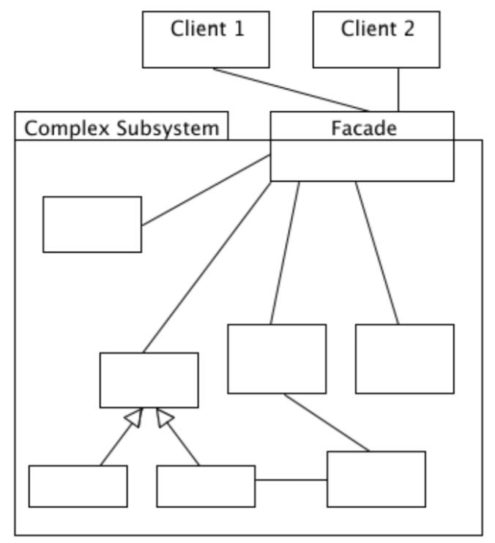
Design Patterns: Facade (Structural)
Facade (Structural)
Problem: There are several dependencies of classes in package A on classes in package B, and developers who want to use the services of package B have to understand the detail of what’s inside it
Solution: Create a Facade class whose job is to present a single, simple interface to package B
Requests for anything in package B are sent to Facade object
The Facade may be a Singleton, but this isn’t always necessary
Advantages
Very useful way to control dependencies; hides a multitude of sins
Lets you redesign a subsystem behind a facade without impacting what is outside
Disadvantage: incurs the cost of extra method calls (usually not a problem)

Slide 14
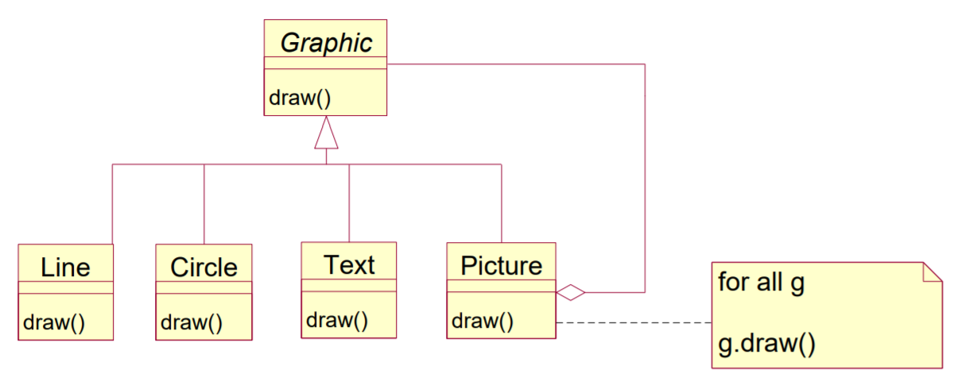
Design Patterns: Composite (Structural)
Problem: Wanting to handle a group of multiple elements as a single element, or a group of a group of elements, without spreading dependencies (tree-like structures)
Solution: To interact with a single class instead of having to know the structure of the tree
Advantages
Can automatically have trees of any depth
Clients simply have to know about one class, without knowing the tree structure
Easy to add new kinds of Graphics subclasses because clients don’t have to be altered
Disadvantages
Difficult to extend for clients that want to know the difference between single graphics and pictures

Slide 15
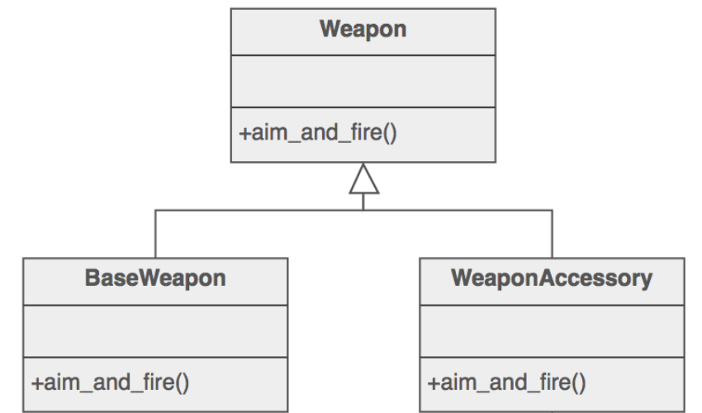
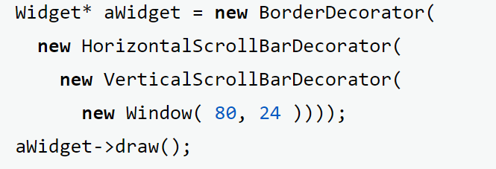
Design Patterns: Decorator (Structural)
Problem: Adding behavior or state to individual objects at run-time
Solution: Attach additional responsibilities to an object dynamically using recursive composition, to allow an unlimited number of decorator "layers" to be added to each core object
Advantages
Lets you add responsibilities to objects without subclassing
Disadvantages
Trying to access the core object directly is now a problem as the core object's identity is "hidden" inside of a decorator object
Similarity to Composite
Both rely on recursive composition to organize a variable number of objects
Decorator can be viewed as a degenerate Composite with only one component
Decorator adds additional responsibilities – not intended for object aggregation
Distinct but complementary; often used together
ChristmasTree
PineTree
ChristmasOrnaments
Lights
Tinsel
Baubles
Composition: Every ChristmasOrnament object consists of a ChristmasTree class/subclass object, until it consists of one PineTree

Slide 16
Design Patterns: Observer (Behavioural)
Problem: Meeting monitoring requirements
Solution: A one-to-many dependency – when one object changes state, all its dependents are notified
“Pull” interaction: When Subject changes, broadcasts to registered Observers that it has changed, each Observer queries the Subject for the change (‘pulls’) (less efficient)
“Push” interaction: Subject ‘pushes’ the change to Observers (more difficult to reuse)
The “View” part of Model-View-Controller

Slide 17
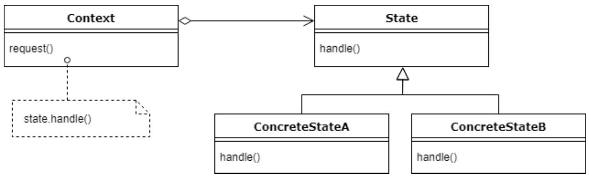
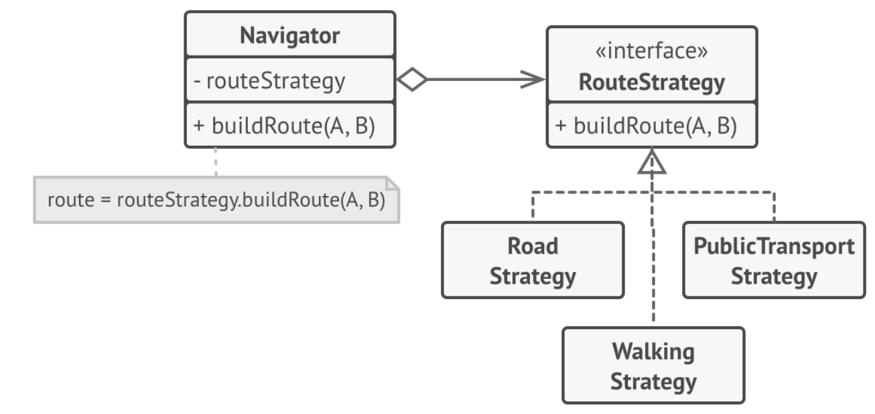
Design Patterns: State, Strategy (Behavioural)
State
Purpose: Make an object’s behaviour change depending on its state, without changing its class (you want an if-else but on a large scale, each option with different method implementations)
Solution: Define different behaviours based on state in separate classes, make their objects interchangeable
Advantages
Client only interacts with Context
Easy to add more states
Disadvantage
Implementation of transition between stages is hardcoded; concrete states are closely coupled
State objects are often Singletons
Strategy
Purpose: Change an object’s behavior in terms of executing algorithm
Solution: Define different algorithms in separate classes, make their objects interchangeable
State is a type of Strategy
Strategy keeps objects completely independent, low coupling
State allows concrete states to alter the context state at will
Parcel
-currentState
+nextState(this) +prevState(this) +setState(toSet: ParcelStatus)
ParcelStatus
+nextState() +prevState()
OrderedState
DeliveringState
ReceivedState
Notes:
https://www.baeldung.com/java-state-design-pattern

Slide 18
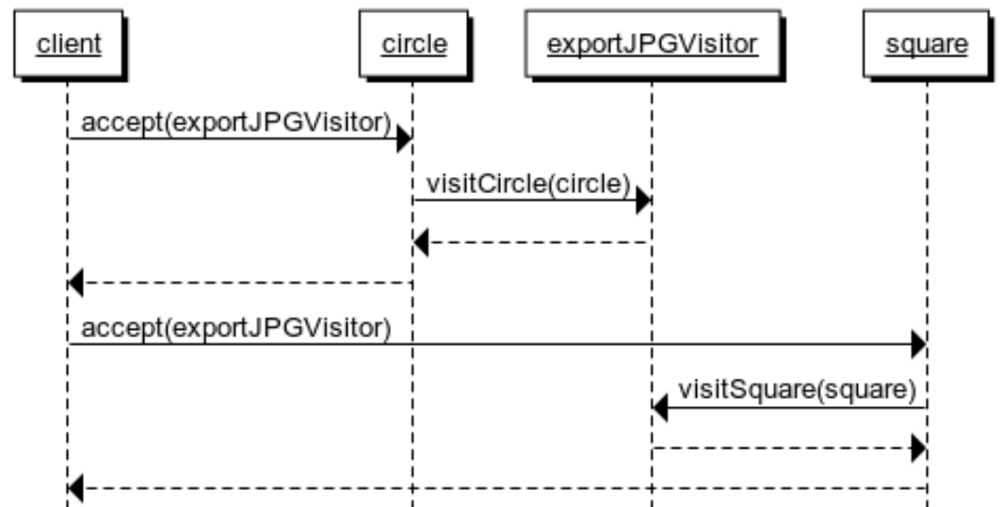
Design Pattern: Visitor (Behavioural)
Purpose: to define additional operations without introducing the modifications to an existing object structure
Solution: add a function which accepts the visitor class to each element of the structure, and hide all methods inside the visitor class
Advantages:
Make the primary classes more focused on their main jobs by extracting all other behaviors into a set of visitor classes (SRP)
Minimal change made to existing classes’ codes (OCP)
Disadvantages:
You need to update all visitors each time a class gets added to or removed from the element hierarchy.
Visitors might lack the necessary access to the private fields and methods of the elements that they’re supposed to work with.
<<interface>>
Visitor
<<interface>>
Shape
+visitCircle(c:Circle)
+visitSquare(s:Square)
Circle
Square
ExportJPGVisitor
ExportPNGVisitor
…
+accept(v:Visitor)
…
+accept(v:Visitor)
+visitCircle(c:Circle)
+visitSquare(s:Square)
+visitCircle(c:Circle)
+visitSquare(s:Square)

Slide 19
Design by Contract
Contract between the supplier of a service and the client
Can be written in English, programming languages, math/logic, a formal specification language, OCL
Advantages:
avoid misunderstanding between 2 parties
ability to assign blame
supports clear documentation
supports defensive programming (verify your contractual conditions)
avoids double testing (testing for pre/post condition)
Contract for a method:
Precondition: must be satisfied when method is invoked
Postcondition: must be ensured by method
Contract for a class:
Must maintain any invariants (eg OCL inv)
Subcontracting for a subclass (for substitutivity):
Demand no more (can have a more general precondition)
Promise no less (can give a more specific postcondition)

Slide 20
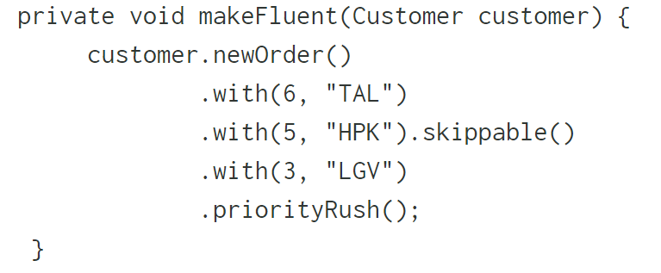
Command-Query Separation
Dividing methods into 2 separate categories:
Commands/Modifiers
Can change an object’s state
Queries
Return a value without changing objects state
Any method should either change state or return a value, but not both
But might be advantageous to disobey if a modifier returns itself, or to pop a stack, or other situations
Why
Able to use queries freely in contracts as they definitely won’t change anything
Confidence in using queries as they do not change anything
Fluent interfaces
Designing an API to be readable and to flow
Requires more effort in thinking and in API construction
Mostly goes against Command Query Separation, inclined to overlook CQS
Disadvantages
On their own, methods don’t make much sense

Slide 21
Domain Specific Language (DSL)
Languages have syntax (grammar), semantics (meaning), pragmatics (context)
DSL: A computer language targeted at a particular problem
Examples: CSS, SQL, regex, etc
Works in a small, specific domain
Internal and external DSLs
Internal DSLs (/fluent interfaces/embedded DSLs)
DSL text written in a program that is written in general processing language (GPL), parsed along with the GPL
eg SQL embedded in Java programs
External DSLs
Has a custom syntax, needs it’s own parser to process
Can suit non-programmers
Graphical DSLs
Normally requires a tool like a Language Workbench
Implementation
Interpretation: executing directly from DSL script, or
Code-generation: generating code from DSL script
Advantages: Can get the exact features you want; can be kept simple, concise, usable
Disadvantages: new and unfamiliar; takes a lot of work, maintenance
Defining a textual DSL
Abstract syntax: generated from the grammar/expressed in ecore
Concrete syntax: define a grammer using xtext
Semantics: eg by generating Java code
Allow people to use it by generating an editor in Eclipse

Slide 22
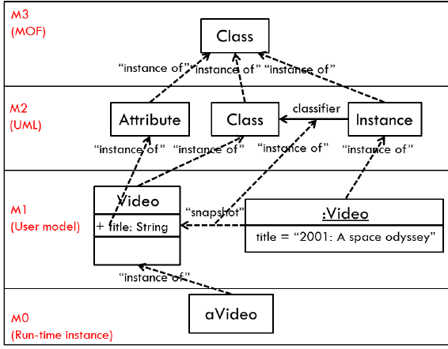
Domain Specific Modelling Languages (DSML)
Problem with define abstract syntax is that graphical languages are not tree-like
Solution: metamodeling
Object Management Group (OMG) 4-level metamodel hierarchy
M0: Real world objects (system snapshot, eg objet diagram of system)
M1: Model (system, eg class diagram of system)
M2: Metamodel (language, eg UML)
M3: Meta-metamodel (meta-language, eg MOF, Ecore)
Defining a DSML
Abstract syntax: define metamodel using ecore
Concrete syntax: define diagrammatic elements
Semantics: eg generate Java code
Allow people to use it via a model editor
Basically, differs from textual DSLS only by the concrete syntax, abstract syntax is the same
Language Workbench
A tool that efficiently supports the development of languages
Typically define various aspects of languages, such as structure, syntax, static semantics, dynamic semantics, as well as various aspects relating to IDEs (code completion, syntax coloring, goto definition, find usages, refactorings).

Slide 23
Basic Xtext
Basic examples
Concerto:
‘concerto' opus=ID description=STRING;
Concert:
'concert' ‘{‘ (programme+=Work)* '}';
Operators
exactly one (the default, no operator)
zero or one (operator ?)
zero or more (operator *)
one or more (operator +)

Slide 24
Model-Driven Development (MDD)
UML diagrams developed in tools before coding, and code generated from/in parallel with them
Strongly influenced by the expected rate of change of the design
Long-lived models for slow changing design
Careful, detailed, tool-supported modelling
Short-lived models for fast-changing design
Easy, agile modelling
Models often written after code is completed
Back to Agile Model:
Counteract slow, document-intensive, expensive software development methods
Manifesto:
Individuas and interactions > processes and tools
Working software > comprehensive documentation
Customer collaboration > contract negotiation
Responding to change > following a plan
Key idea: Simple designs are easier to change and less error prone
Method of testing:
Refactor the code in small increments until it is how you want it to be
Code should now be in good shape with a clean, simple, tested design
Write new tests that will fail
Make changes, rerun all tests until they pass

Slide 25
Model-Driven Development (MDD)
In MDD, models are important artefacts in development
Decisions recorded in one model can be updated in all other models and code using model transformations
Model transformations
A program that can create/modify a model using information from other models
eg code generators, documentation generators
Bidirectional transformations (bx)
Problem: Maintaining consistency between various models with separate concerns
Two responsibilities:
Check whether given models are consistent
If inconsistent, change one to restore consistency, assuming that the others must not be changed
Things to note
Models that are already consistent should not be changed
Some properties cannot be guaranteed e.g. changing one model, bx, change it back, bx, does not guarantee the same start and end model
Bijective – special case of bx
One-to-one mapping in model spaces (eg M & N); when all models in M have one and only one corresponding model in N, where the predefined relationship R is upheld
For the transformation m->n, there exists an inverse function that takes n->m
However, it should not be enforced that all bx are bijective because
A model might not be fully translatable (eg a full UML model to a RDBMS schema), so one-to-one mapping might not be possible
Difficult to resolve inconsistencies (eg deleting a part of one might not mean you want to delete the corresponding part of the other)

Slide 26
MDD: Model Transformation Languages
Queries, Views and Transformations – Relations (QVT-R)
Declarative, bidirectional language for specifying the relationship between models
Sort of a DSL for expressing bidirectional transformations
Checkonly mode
Checks whether models are consistent, returns true or false
Enforce mode
Changes one of the models to be consistent with the other
Advantages: Can express what consistency means, well adapted to models in languages defined using MOF (like UML)
Disadvantages: Lack of tools, clarity, consistency among tools
Triple Graph Grammars (TGGs)
Defining bx using a collection of triple rules, with integrated triple graphs
Good tool support, theoretically well-developed, notations are good, but
Difficult to write, some other problems like when deleting elements
Somewhat a dead-end

